Slide 1
Multiplexers & Demultiplexers

Slide 2
Multiplexers
A multiplexer has
2n data inputs
n control inputs
1 output
A multiplexer routes (or connects) the selected data input to the output.
The value of the control inputs determines the data input that is selected.

Slide 3
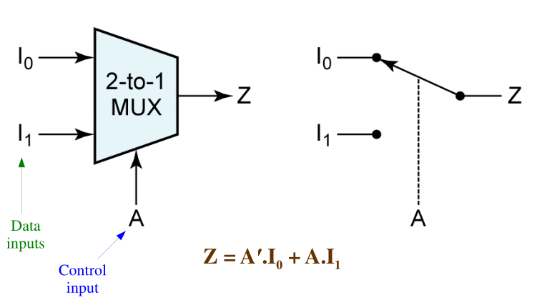
Multiplexers (2x1)

Slide 4
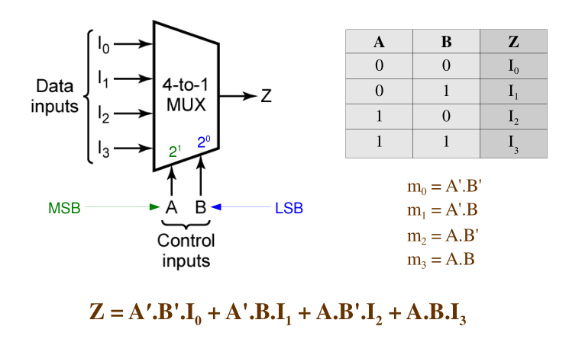
Multiplexers

Slide 5
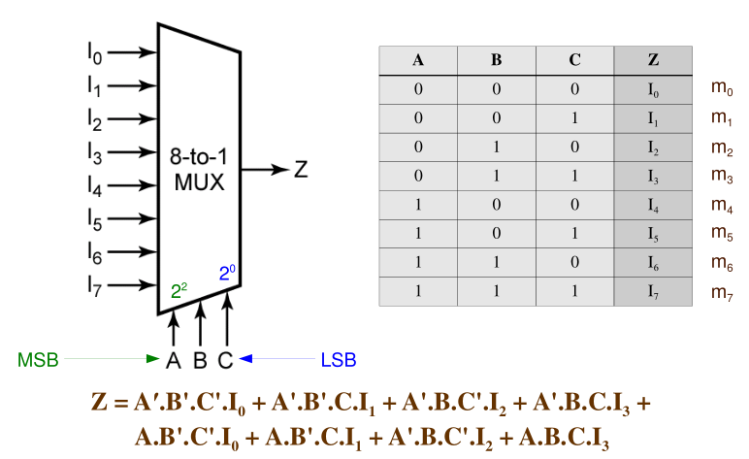

Slide 6
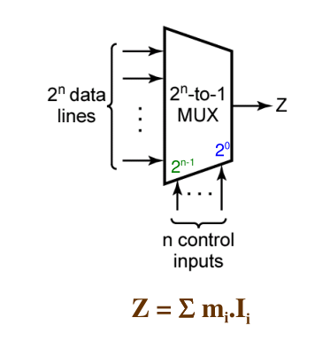

Slide 7
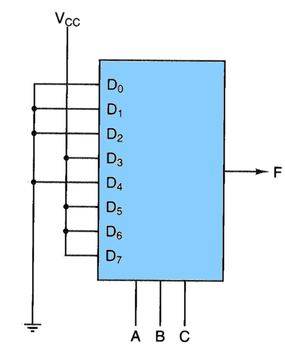
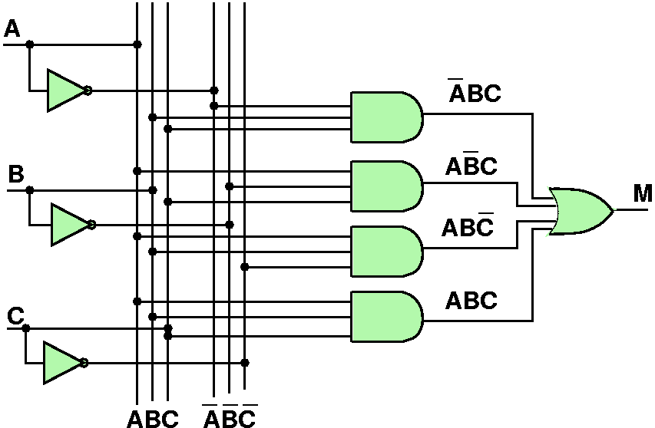
Circuit Synthesis with Multiplexers
boolean function of three variables can easily be created with an 8 input MUX
Just wire input D_{n} to Vcc(1) if the n-th row of the truth table has a '1' and to ground otherwise
A | B | C | M
0 | 0 | 0 | 0
0 | 0 | 1 | 0
0 | 1 | 0 | 0
0 | 1 | 1 | 1
1 | 0 | 0 | 0
1 | 0 | 1 | 1
1 | 1 | 0 | 1
1 | 1 | 1 | 1

Slide 8
Using an 2 (n-1) -input Multiplexer
● Use a 2 (n-1) -input multiplexer to realize a logic circuit for a function with 2 n minterms.
n – 1 = # of control inputs; n = # of variables in function
● Group the rows of the truth table, for the function, into 2 (n-1) pairs of rows.
Each pair of rows represents a product term of (n – 1) variables.
Each pair of rows is mapped to one data input of the mux.
● Determine the logical function of each pair of rows in terms of the remaining variable.
If the remaining variable, for example, is x, then the possible values are x, x', 0, and 1.

Slide 9
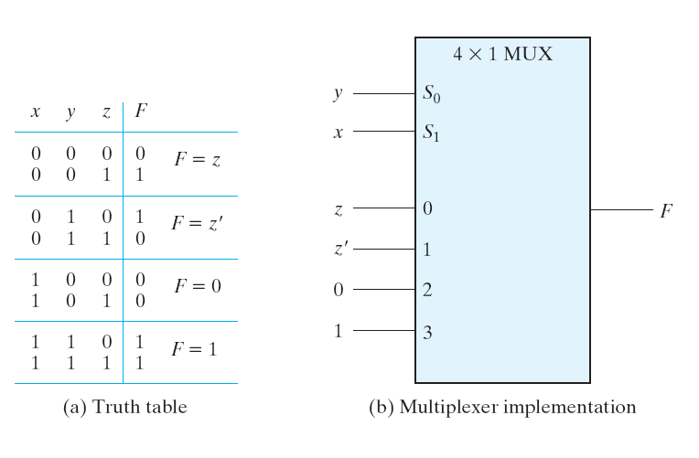
F(x,y,z) = Σm(1, 2, 6, 7)

Slide 10
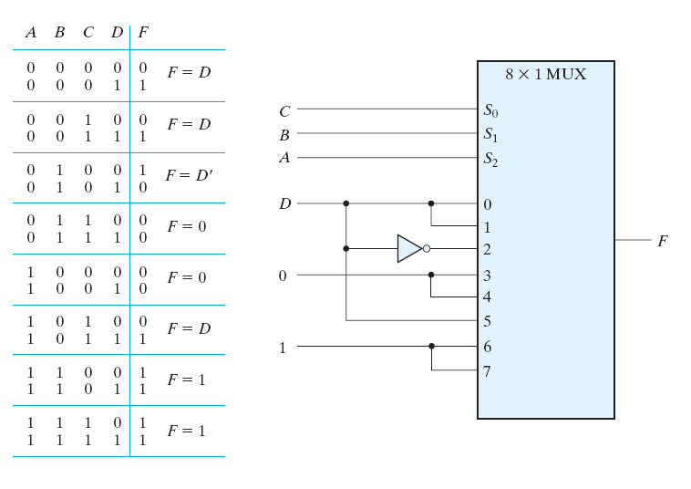
F(A,B,C,D) = Σm(1,3,4,11,12–15)

Slide 11
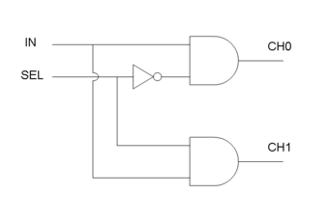
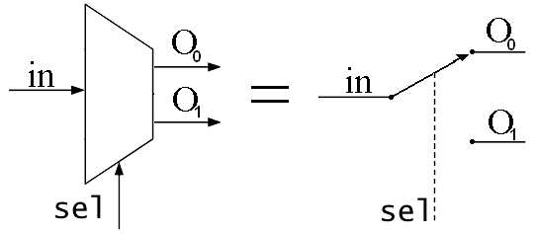
Demultiplexers
a.k.a. DEMUX
direct input to one of several outputs

Slide 12
